Slide 1

DC Housing Pricing Prediction
Team: Emmanuel Brim, Sied Mohamed , Kyle Sawitzke, Diana Seveney

Slide 2



What to expect:
Project Background, Topic and Data Sources
Data Exploration, Machine Learning
Dashboard Demo, Questions answered, What can we do more?

Slide 3

About Project
Real estate is a hot market . We are Interested in seeing how various factors affect the price of a home in DC area
Model can help buyers or sellers to determine if the property they're interested in buying/selling is accurately priced

Slide 4

What Questions We Hope to Answer?
How does Prime Rate affect home value?
School Rank
Future price prediction
Prime Rate
Does the rating of schools affect the home price? If so, how?
if the property byers/sellers interested in is accurately priced and is on up- or down- trend in upcoming years?

Slide 5

Data Sources
Kaggle: Preparing the D.C. Real Property Dataset
SchoolDigger.com: District of Columbia High School Rankings
DC Public Schools : School List
FRED Economic Data: Bank Prime Loan Rate Changes: Historical Dates of Changes and Rates (PRIME)
This Photo by Unknown Author is licensed under CC BY-SA-NC

Slide 6








Technology Workflow for the project

Slide 7

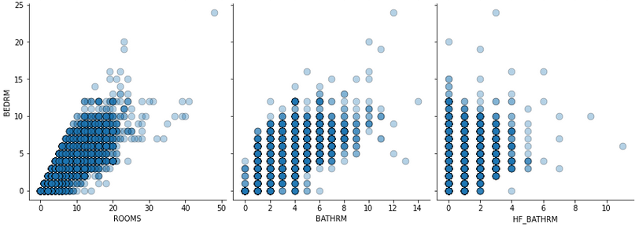
Exploratory Data Analysis
Tools: Jupyter Notebook - Pandas, Matplotlib, Numpy, Seaborn
Loaded Data
Created DataFrame
Explored the Data
Changed Data Types
Visualized Features
Selected features that were most relevant to the analysis
Used visualizations & descriptive statistics. Determined data types, value counts & checked for null values.
Utilized scatterplots to look for any correlations
Main Takeaway:
Many outliers in the dataset
Ex. Homes with 25+ rooms and over 8+ bathrooms
We hypothesized that there were other types of real estate and decided to use Price per Bdr or Price per Room to normalize the data set.

Slide 8
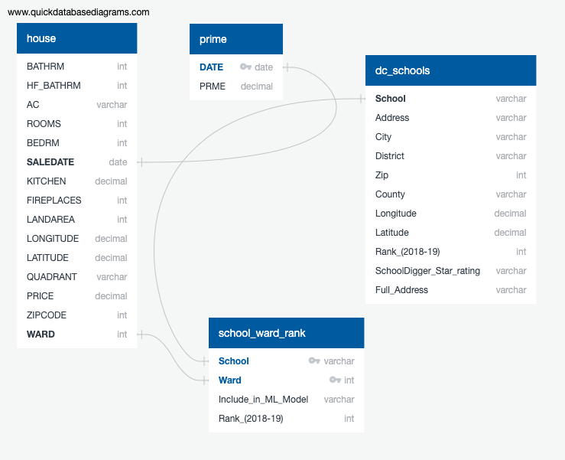
SQL Database- Data points and connections

Slide 9

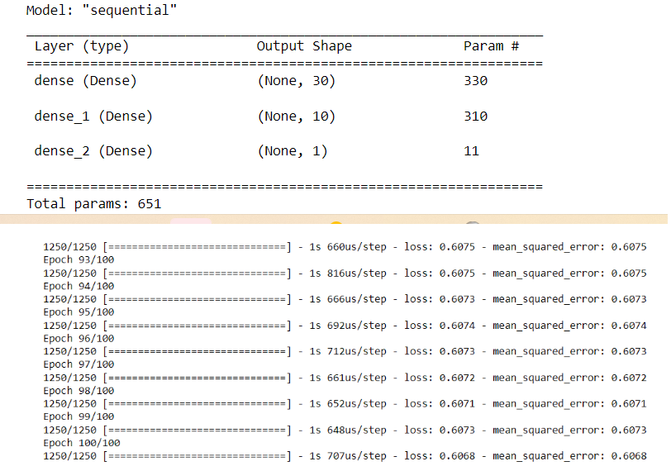
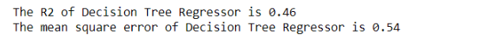

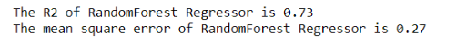
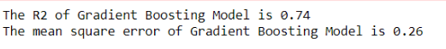
Machine Learning
Attempted Models: RandomForestRegressor, LinearRegression, Gradient Boost Model, Decision Tree Regressor , Deep Learning
Based on the above results, Gradient Boost model and Random Forest Regressor have the highest R2 and lowest mean squared error as a result most accurate. Gradient Boost model is used to predict our data.

Slide 10

Dashboard Prototype
Demonstration
Link to Dashboard

Slide 11

What are the results?
This Photo by Unknown Author is licensed under CC BY-SA

Slide 12
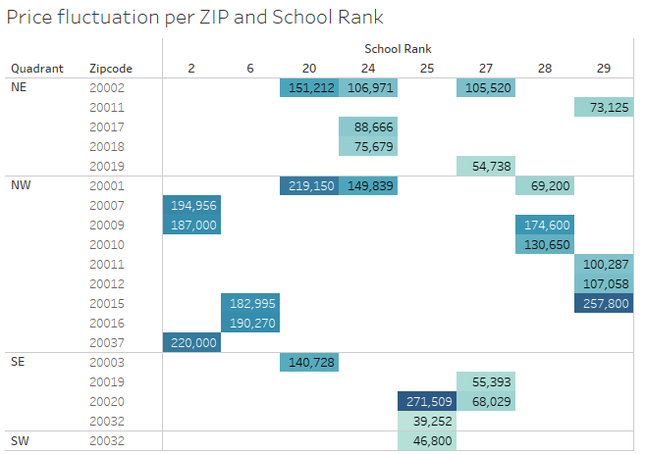
Does the rating of schools affect the home price? If so, how?
There is a direct correlation to the Ranking of the school. As seen in this example, within the same Zip code, the price per Bedroom (example 3 bedroom house/apt) varies by 30% between high and lower-ranked school

Slide 13
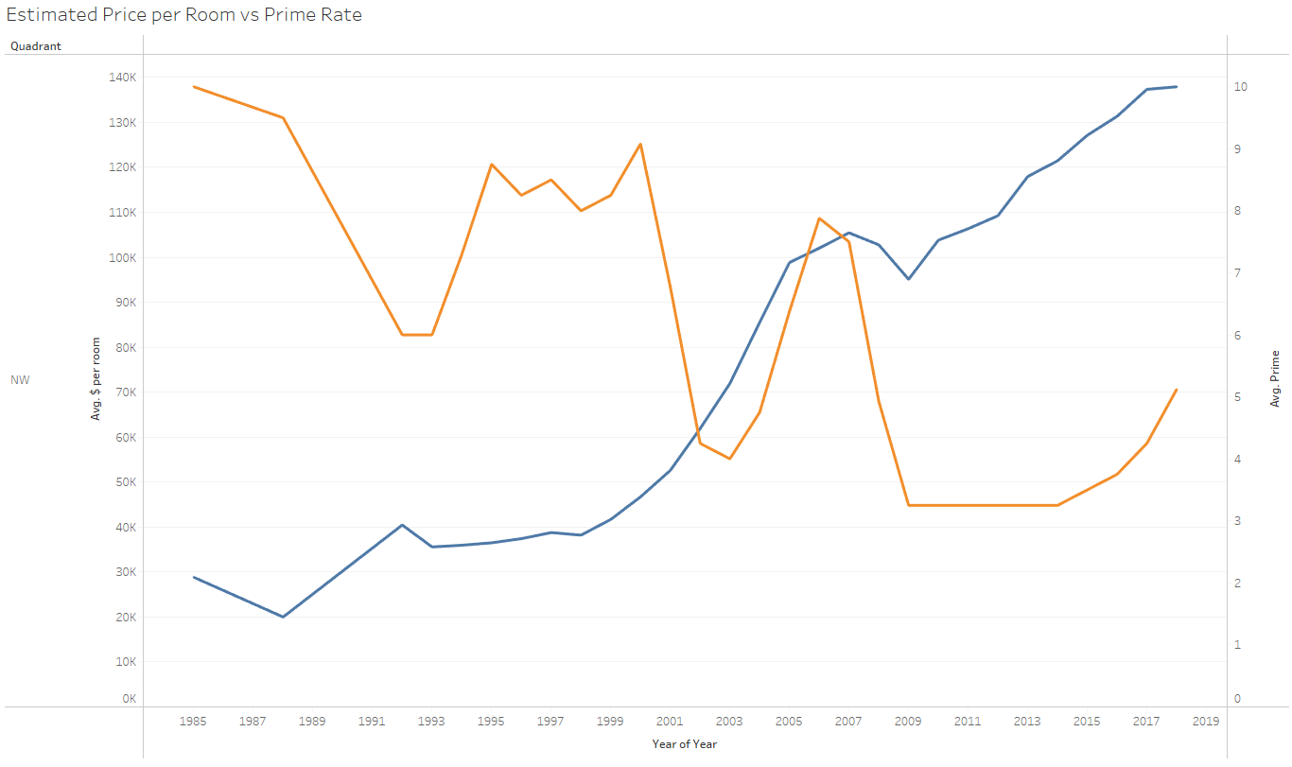
How does Prime Rate affect home price?
Over a 30-plus year horizon, we do see a negative relation between Price per room and Prime rate difference. However, in the past 10 years, that correlation is less vivid. It looks like depending on the location and size of the house, the impact of Prime Rate is variable.

Slide 14
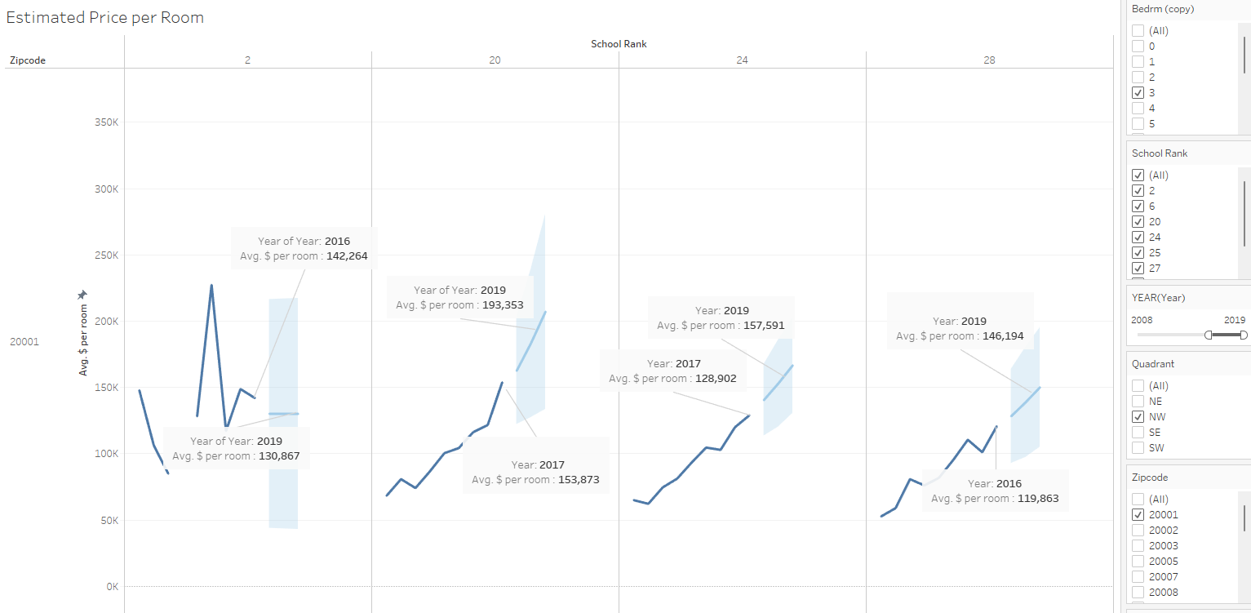
if the property byers/sellers interested in is accurately priced and is on up- or down- trend in upcoming years?
The Interactive Dashboard would provide current and future average Price per Room based on buyer/seller selection of the Number of Bdr, location (DC region and zip), and school ranking.
Buyers/sellers will be able to determine if the home they are looking to purchase/sell is above or below avg price and if in the future there is an upstream or downstream effect. It is important to note that this model does not take into account Year build, Sq, Condition, etc

Slide 15


Our Recommendation for Future Exploration
How does crime affect home prices in specific areas?
How does the proximity to public transportation affect home prices?
How does the presence and distance to hospitals affect home prices?

Slide 16

What Would We Do Differently?
Finding Data
Exploring other data sources early on (relied heavily on Kaggle)
Not settling for a dataset
ML Model
Attempt other models i.e. Lasso Regression
If a larger dataset was found, attempt a Neural Network

Slide 17

Questions?
This Photo by Unknown Author is licensed under CC BY

